Slide 1
UC Merced land use data
Arjun Arora, Usul Hamdi
Dr.-Ing. Mehdi Maboudi, Dr. Diaz Pedro

Slide 2
Introduction
This is a 21 class land use image dataset used for research purposes.
It contains 100 images for each of the 21 classes.
Each image has a resolution of 256x256 pixels.
The pixel resolution of each image is 0.3048 m.
The images are manually extracted form large USGS National map urban area Imagery collection for various urban areas around the country.
Classification of remote sensing image dataset.

Slide 3
Source
The data is from a 2010 paper by Yi Yang and Shawn Newsam called "Bag-Of-Visual-Words and Spatial Extensions for Land-Use Classification," ACM SIGSPATIAL International Conference on Advances in Geographic Information Systems (ACM GIS), 2010.

Slide 4
Classes in dataset
There are 100 images for each of the following classes:
agricultural
airplane
baseballdiamond
beach
buildings
chaparral
denseresidential
forest
freeway
golfcourse
harbor
intersection
mediumresidential
mobilehomepark
overpass
parkinglot
river
runway
sparseresidential
storagetanks
tenniscourt

Slide 5
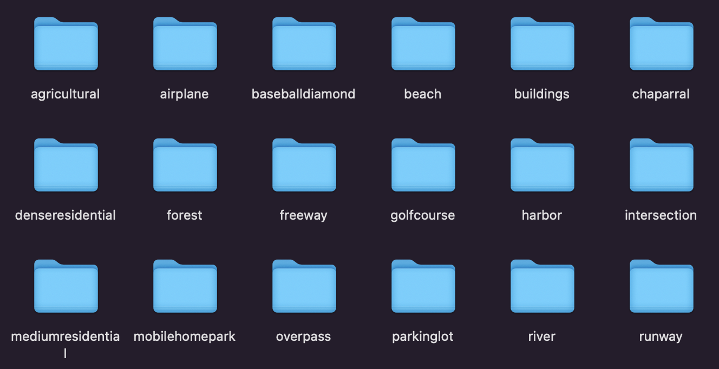
Dataset raw
21 subfolders with class names

Slide 6
Data sample

Slide 9
Land use
Dataset | UCM
Resolution | 0.3048m
Classes | 21
Total samples | 2100
Obtained | Aerial imagery
Geolocations | USA
The aim of this dataset is masking of regions where land is being used in
satellite images obtained through Landsat.
Land use is an important problem of modern world which involves planning,
Management and modifications of natural environment and available land.
It gives us a glimpse of our land use coverage, which type of establishments
Cover the most space etc.
This is a basic dataset through which we can look at the approach to work on
Land use data in remote sensing.

Slide 10
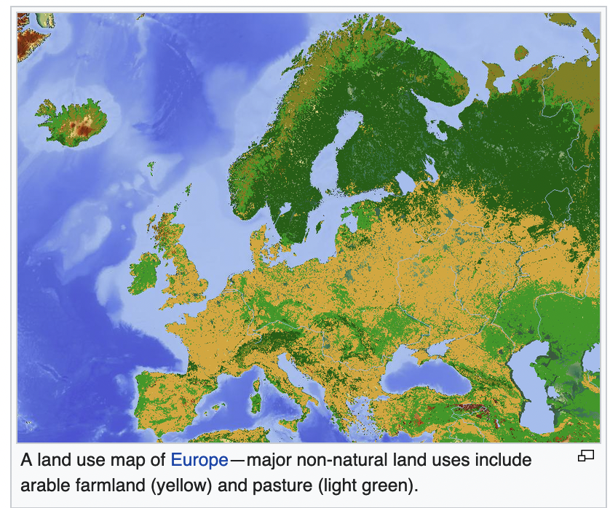
Data applications

Slide 11
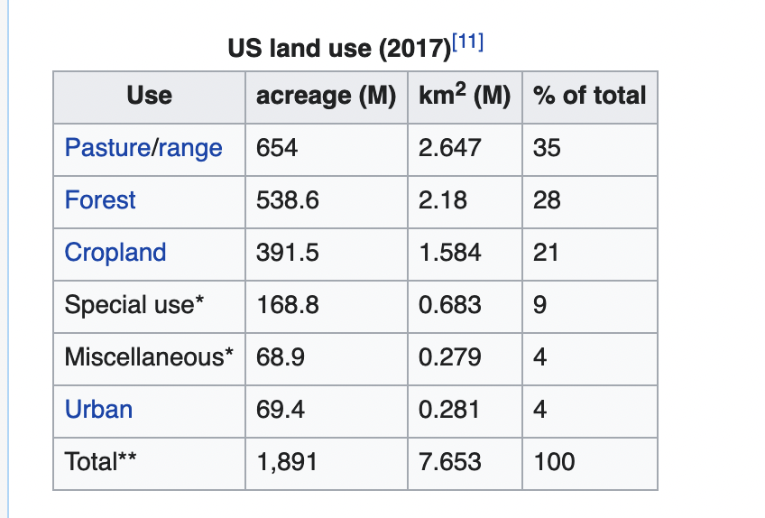
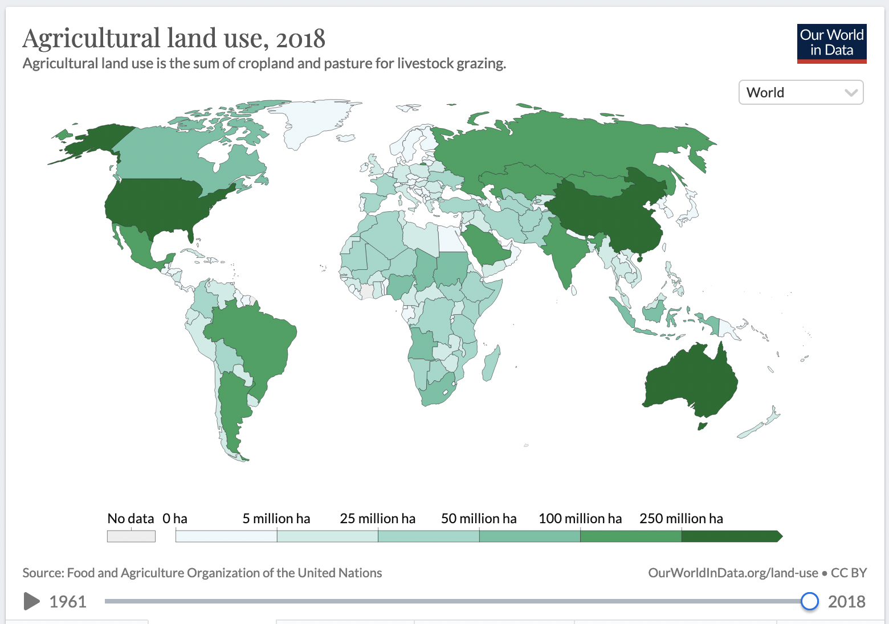
Data applications

Slide 12
Data loading
The data is provided as a zip-file of 21 folders containing 100 images for each class.
We split the data to training, test and validation using a custom function.
We use keras.utils.image_dataset_from_directory function to then load the training test and validation data for each class at once.
This function returns a tf.data.Dataset type of tensorflow object containing the images.
As this function does not support tif image format(“Tagged Image File Format”, a high quality graphics image), we need to convert the images to jpg first.

Slide 13
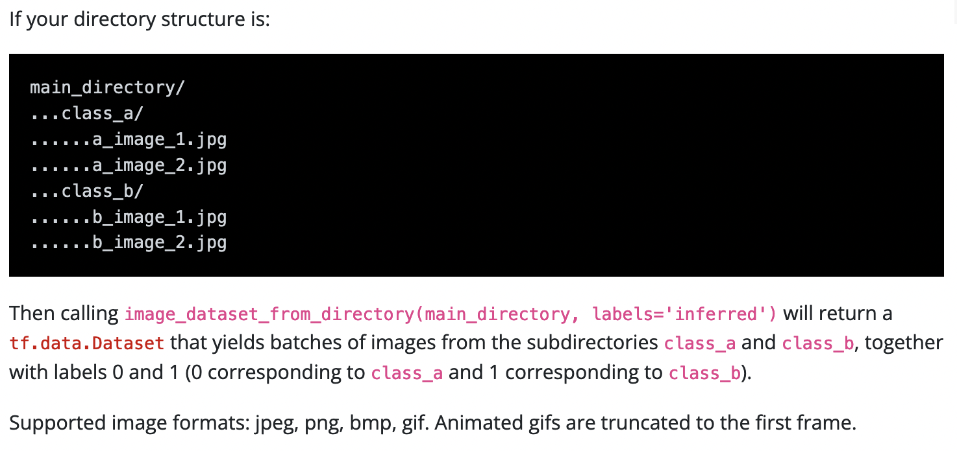

Slide 14
EDA - Classes
As each class has 100 samples, the classes are perfectly balanced.
We can use data augmentation to increase the image samples by using rotation, flipping, cropping etc.
In case of training with data augmentation, using a CNN model would be beneficial as its performance does not vary due to augmented images.
# Read train and test data from image directories
train = keras.utils.image_dataset_from_directory("archive/images_train_test_val/train")
test = keras.utils.image_dataset_from_directory("archive/images_train_test_val/test")
val = keras.utils.image_dataset_from_directory("archive/images_train_test_val/validation")

Slide 15
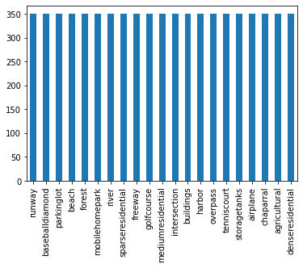
Samples per class

Slide 16
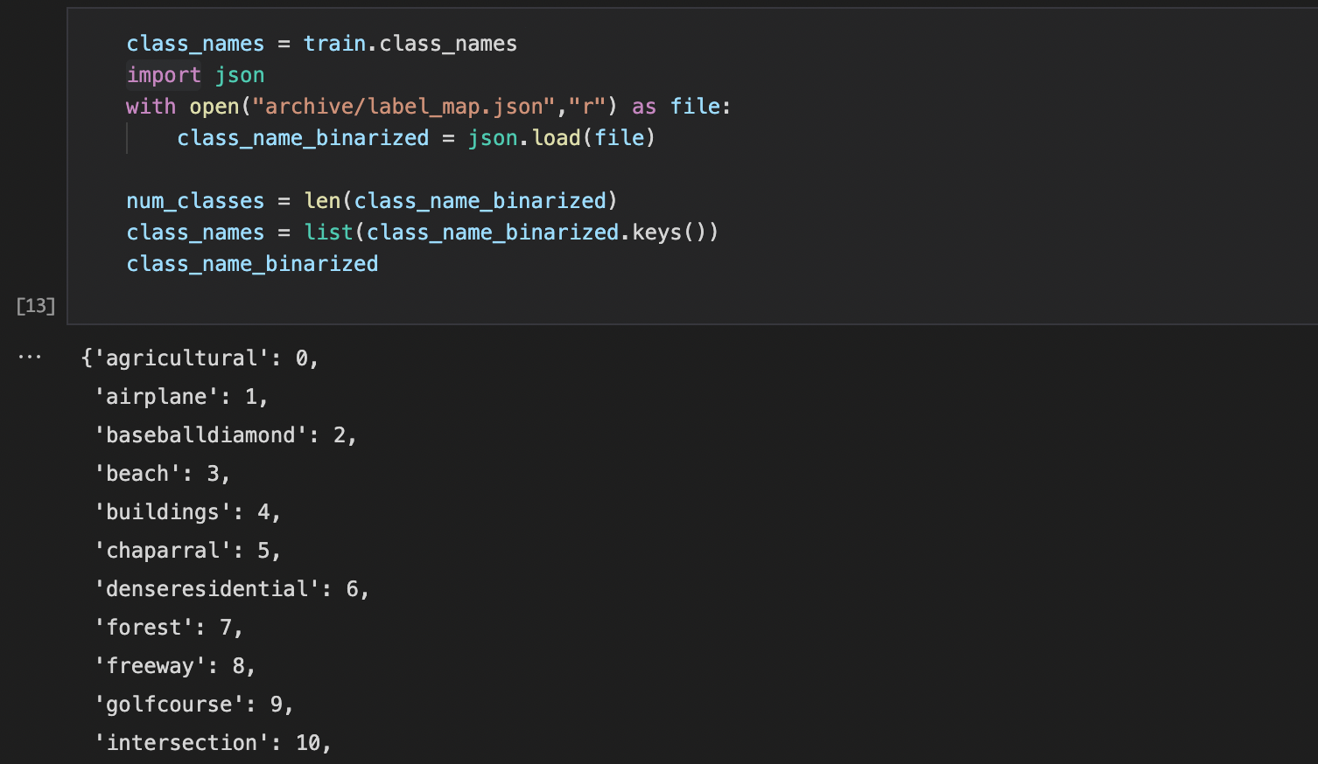
Assigning class numbers

Slide 17
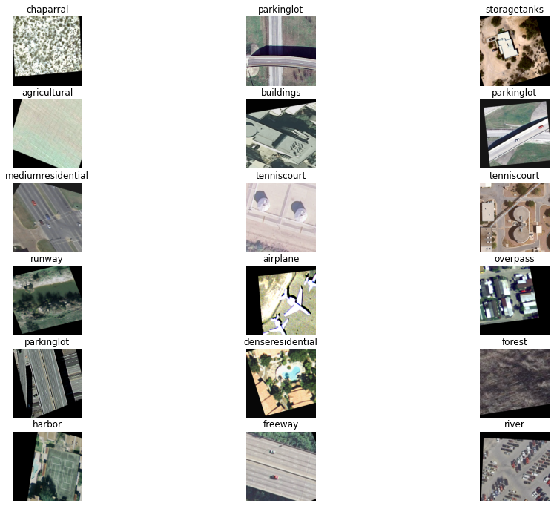
Train data
Training samples

Slide 18
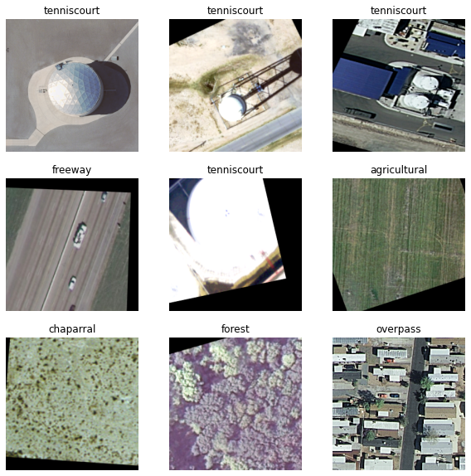
Test
Test samples

Slide 19
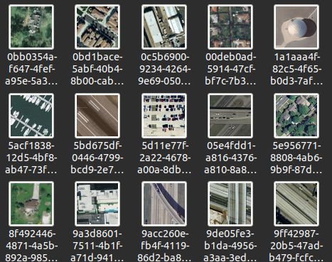
Human level performance
After analyzing the dataset, it was clear that some classes (buildings, denseresidential, mediumresidential, mobilehomepark) were too close to each other.
We wanted to analyze human level performance, we randomly sampled 10 image from the each class and put it into a folder with no mention of the label

Slide 20
Human level performance
And we tried to guess those labels ourselves.
Out of 199 labels, we guessed 181 correctly.
The ones that we classified incorrectly:
Label | Guess | Label | Guess
denseresidential | mobilehomepark | mobilehomepark | buildings
buildings | denseresidentia | golfcourse | agricultural
golfcourse | agricultural | mobilehomepark | denseresidential
intersection | overpass | mediumresidential | denseresidential
mediumresidential | denseresidential | sparseresidential | buildings
denseresidential | mobilehomepark | mediumresidential | denseresidential
mobilehomepark | denseresidential | denseresidential | mediumresidential
golfcourse | agricultural | forest | chaparral
golfcourse | agricultural | denseresidential | buildings

Slide 21
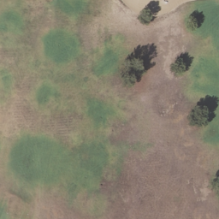
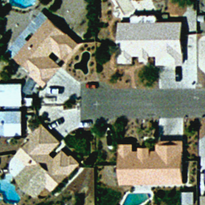
Human level performance
As we suspected, medium, dense, spare residential areas, buildings and mobile park classes are easy to confuse.
But also we also confused golf course with agricultural areas and vice versa.
Golf course or agricultural?
Dense or medium?

Slide 22
References
Yi Yang and Shawn Newsam, "Bag-Of-Visual-Words and Spatial Extensions for Land-Use Classification," ACM SIGSPATIAL International Conference on Advances in Geographic Information Systems (ACM GIS), 2010.
https://www.kaggle.com/datasets/apollo2506/landuse-scene-classification
https://keras.io/api/data_loading/image/
https://www.paintshoppro.com/en/pages/tif-file/
https://elib.dlr.de/130278/1/08899080.pdf
https://en.wikipedia.org/wiki/File:Europe_land_use_map.png

Slide 23
THANK YOU

